Slide 1
Comparative Analysis of Explainable
Machine Learning Models for Business Analytics
Project Review – 2
B LAKSHMI SAI PRASANNA 2420030525
A NEHA REDDY 2420030508
Y DIVYA SRI 2420030529

Slide 2
METHODOLOGY
Implemented data preprocessing for Bank Marketing, Online Retail, and Telco Customer Churn datasets.
Implemented exploratory data analysis (EDA) to analyze distributions, correlations, class balance, and important data patterns.
Implemented feature engineering to generate meaningful business-related features from the raw datasets.
Implemented feature selection to identify relevant features and remove unnecessary/constant features.
Implemented four machine learning models: Logistic Regression, Decision Tree, Random Forest, and XGBoost.
Generated and stored model predictions and performance results for all three datasets.

Slide 3
Methodology - EHEM, XAI and Evaluation
Implemented the Explainable Hybrid Ensemble Model (EHEM) by combining Logistic Regression, Random Forest, and XGBoost.
Implemented validation-based model weighting using ROC-AUC performance and optimized the prediction threshold using validation F1-score.
Implemented SHAP-based explainability to identify global feature importance and feature contributions to predictions.
Implemented LIME-based explainability to generate local explanations for individual predictions.
Implemented quantitative XAI evaluation using Fidelity, Sparsity, and SHAP–LIME Top-5 consistency.
Implemented comparative analysis of individual ML models and EHEM using Accuracy, Precision, Recall, F1-Score, and ROC-AUC.

Slide 4
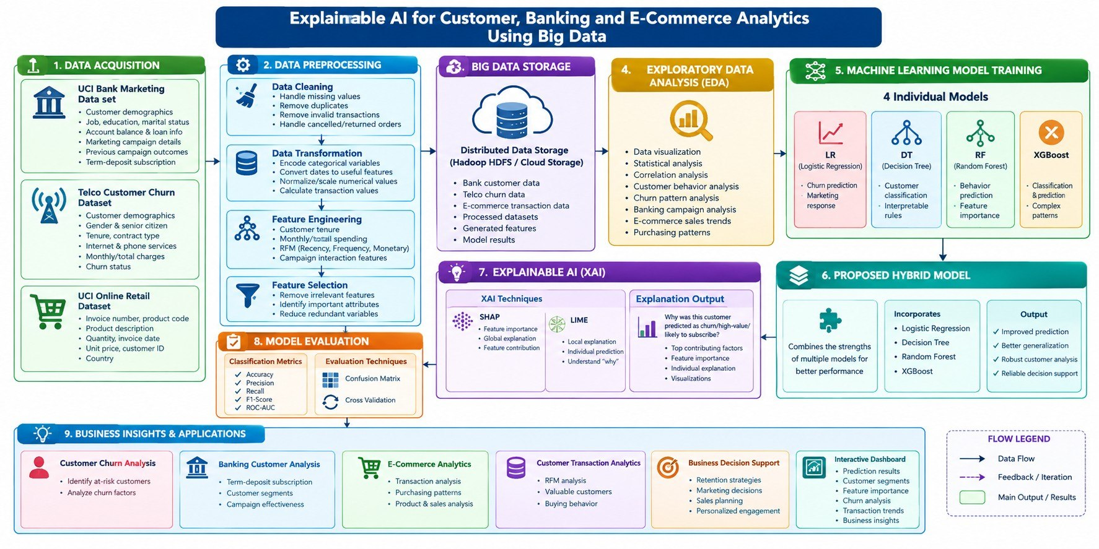
SYSTEM DESIGN

Slide 5
Modern tools and technologies
Programming
ML / Data
Python • HTML • CSS • JavaScript
• Pandas • NumPy • Scikit-learn • XGBoost
• Logistic Regression • Decision Tree
• Random Forest
Visualization
Explainable AI
Matplotlib • Seaborn • Interactive dashboard
SHAP • LIME
Development
Project Output
VS Code • Python virtual environment
CSV results • PNG graphs • HTML LIME explanations • Web dashboard

Slide 6
implementation
Dataset Processing: Implemented preprocessing, feature engineering, and feature selection for Bank Marketing, Online Retail, and Telco Customer Churn datasets.
Model Development: Implemented and trained Logistic Regression, Decision Tree, Random Forest, and XGBoost models for business prediction tasks.
Hybrid Model: Developed the Explainable Hybrid Ensemble Model (EHEM) by combining Logistic Regression, Random Forest, and XGBoost using validation-based model weights.
Explainability & Analysis: Integrated SHAP and LIME with the developed models and generated performance, feature-importance, and explanation results for comparative analysis.

Slide 7
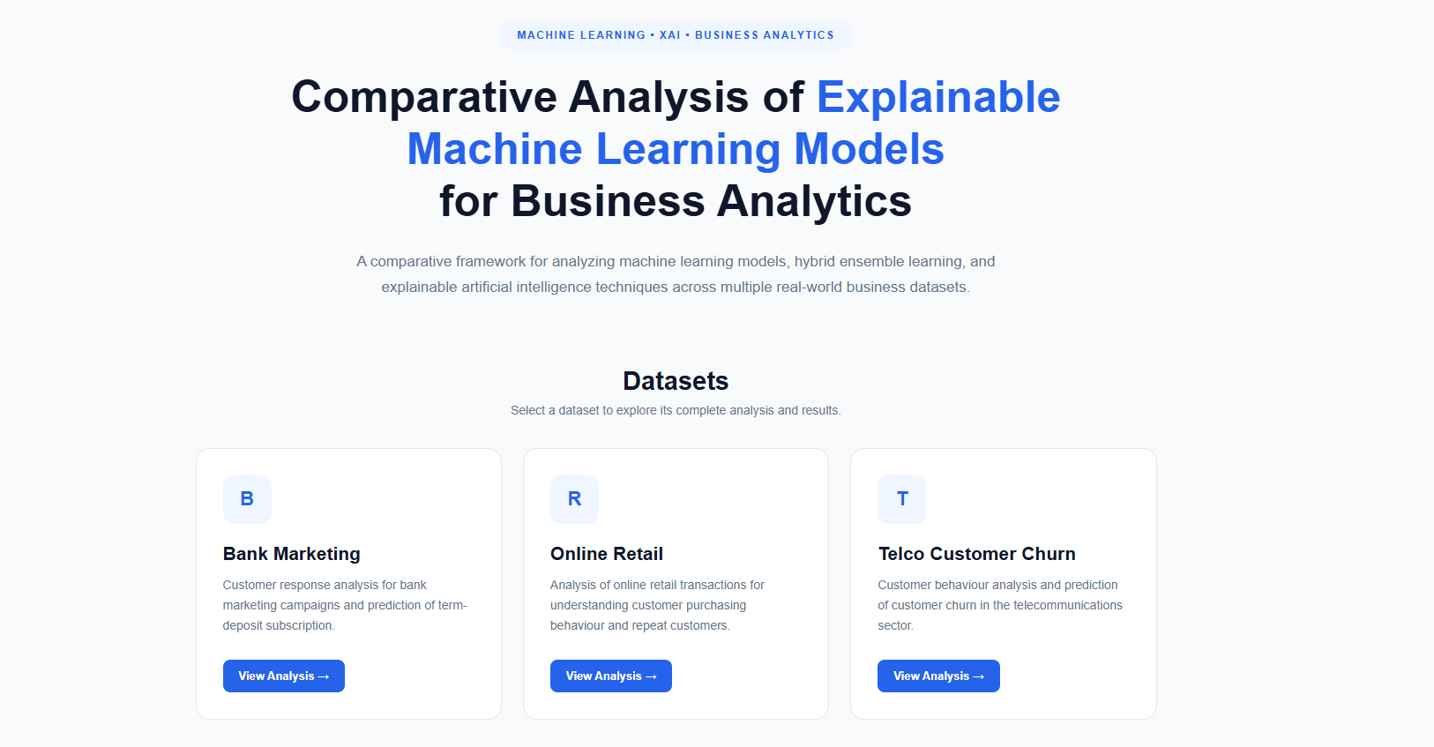
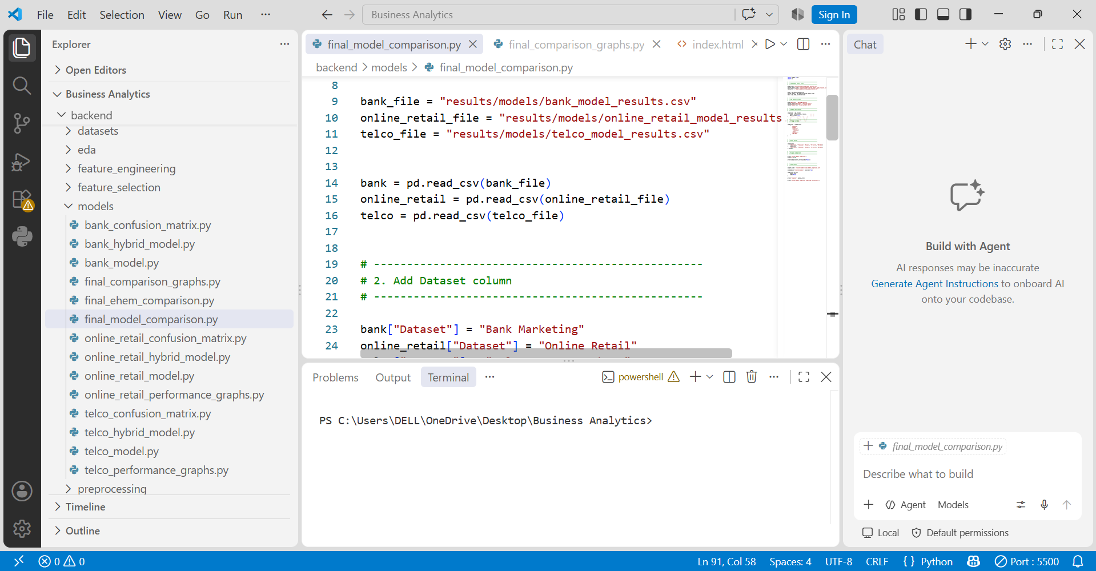

Slide 8
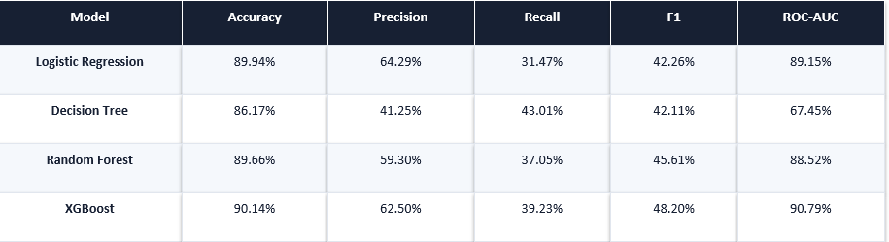
Results – bank marketing

Slide 9
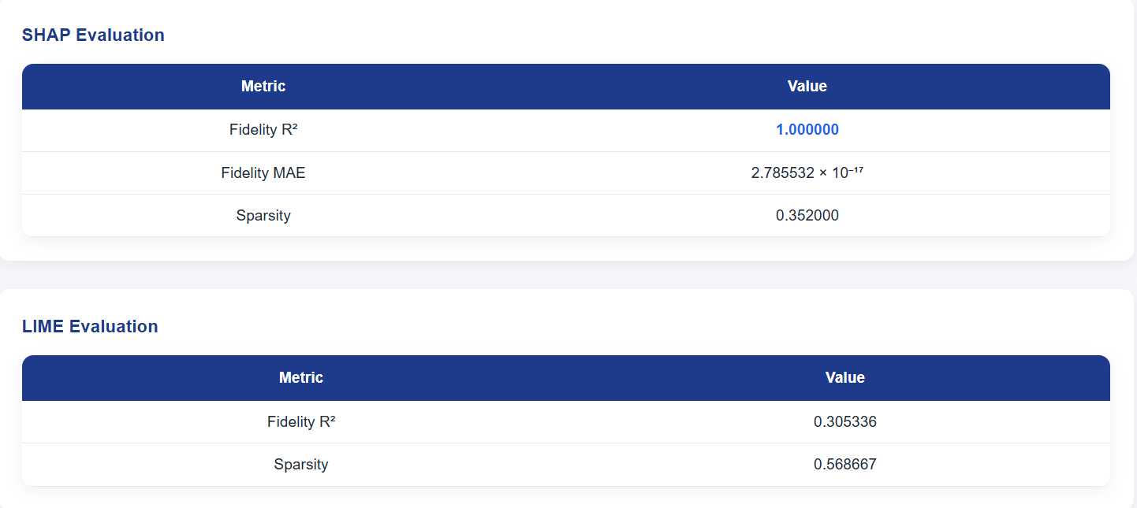

Slide 10
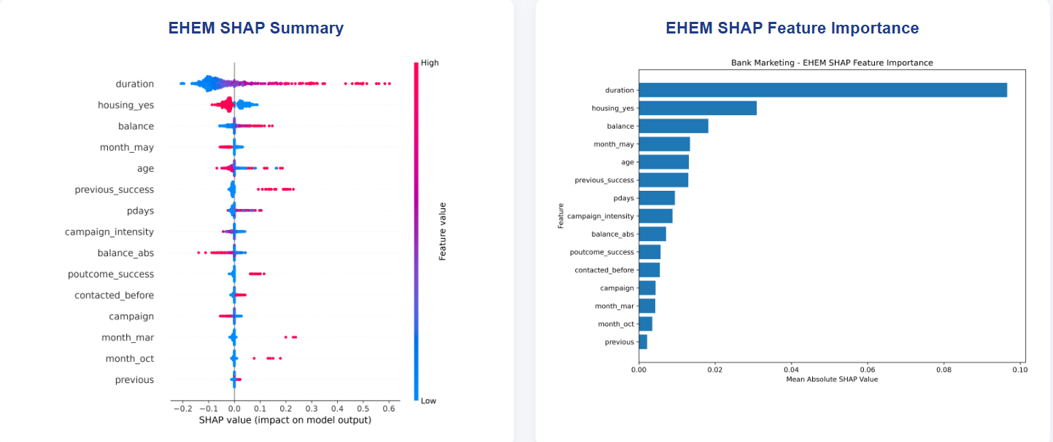

Slide 11
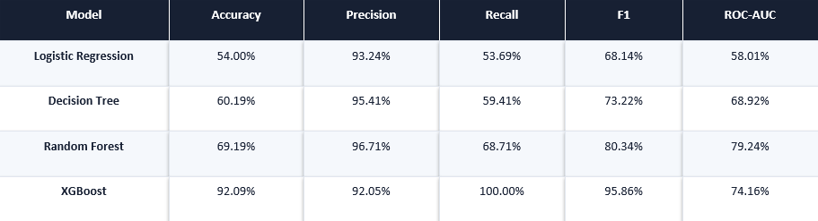
Results – online retail

Slide 12
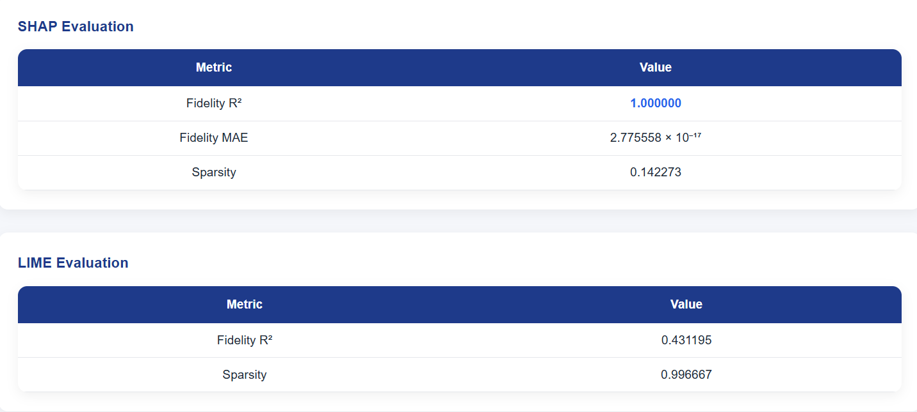

Slide 13
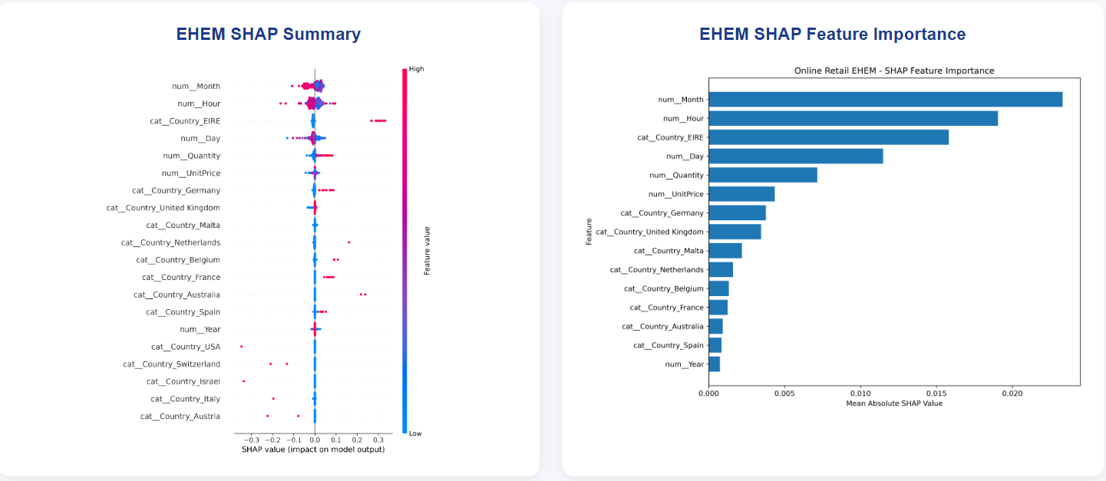

Slide 14
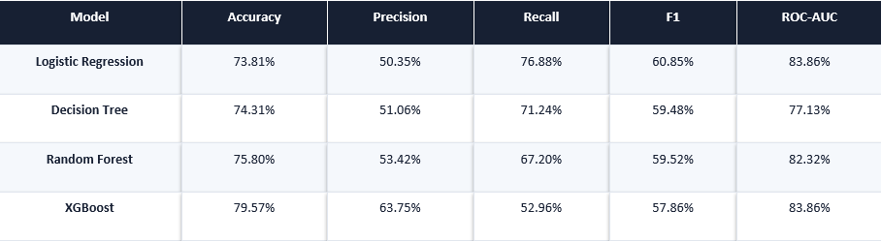
Results – telco customer churn

Slide 15
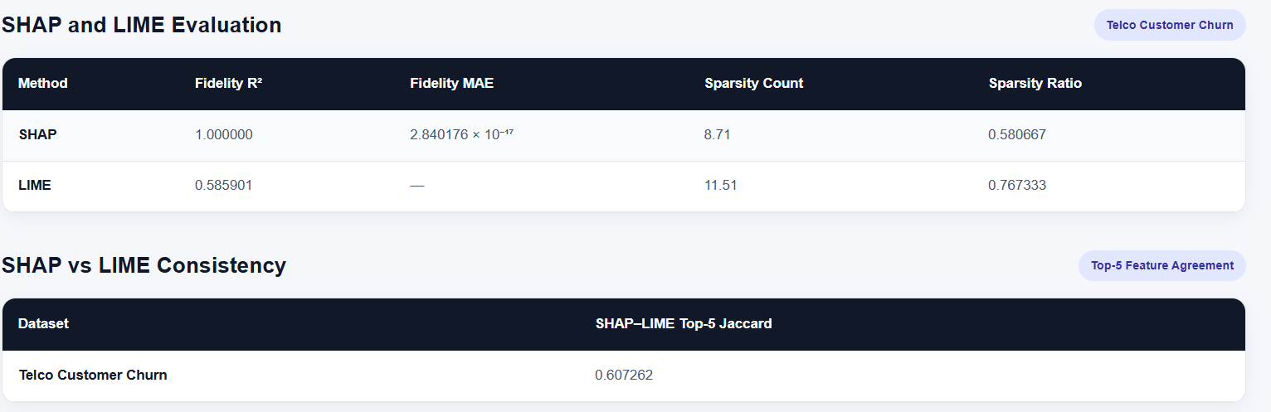

Slide 16
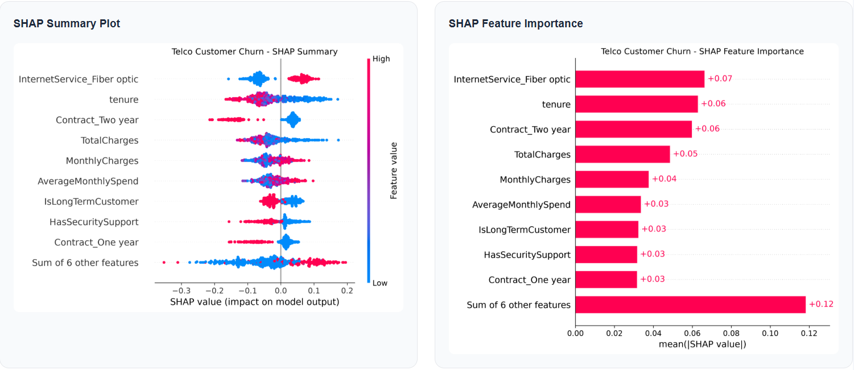

Slide 17
Performance evaluation
Bank Marketing
Online Retail
Telco Churn
XGBoost achieved the highest Accuracy (90.14%), F1-score (48.20%) and ROC-AUC (90.79%).
Logistic Regression had the highest Precision (64.29%), while Decision Tree had the highest Recall (43.01%).
Current XGBoost results show 92.09% Accuracy and 95.86% F1-score, but ROC-AUC is 74.16%.
These results are treated as preliminary because the transaction/customer split requires refinement.
XGBoost achieved the highest Accuracy (79.57%) and Precision (63.75%).
Logistic Regression achieved the highest Recall (76.88%) and F1-score (60.85%).

Slide 18
Novelty/innovation
Proposed Innovation
A hybrid predictive–explainability framework that evaluates both model prediction quality and consistency of explanations.
Hybrid Prediction Layer
Explainability Consistency Layer
Combine outputs/probabilities from multiple ML models using a validation-based weighting strategy.
The purpose is to investigate whether a combined predictor can improve robustness over individual models.
Compare important features identified by SHAP and LIME and calculate an explanation-agreement measure.
This adds a quantitative explainability criterion instead of only displaying XAI plots.

Slide 19
Future Scope & Conclusion
Future Scope
Conclusion
• Implement and validate the hybrid prediction layer.
• Implement SHAP–LIME explanation-consistency score.
• Refine Online Retail evaluation using a leakage-aware split and prediction setup.
• Tune model thresholds and hyperparameters.
• Complete comparative business insights and final paper experiments.
• Integrate validated outputs into the dashboard.
The project has progressed from data preparation to working ML and XAI modules across three business datasets.
Performance evaluation and confusion-matrix analysis are available for the implemented models.
SHAP and LIME provide complementary global and local explanations.
The proposed hybrid predictive–explainability layer will strengthen the final research contribution after validation.

